Slide 1

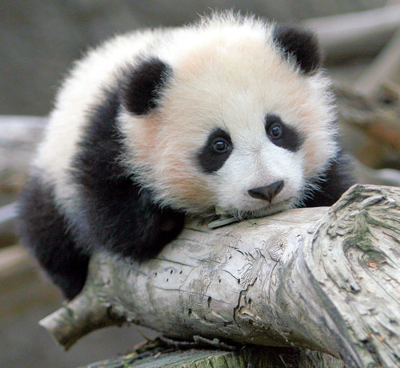
FLL Animal Allies
Stay Calm, Save a Panda, Be Happy!!!
Machines, Inc. Team #5041

Slide 2
Core Values
1). We are a team.
2). We do the work to find solutions with guidance from our coaches and mentors.
3). We know our coaches and mentors don't have all the answers; we learn together.
4). We honor the spirit of friendly competition.
5). What we discover is more important than what we win.
6). We share our experiences with others.
7). We display Gracious Professionalism® and Coopertition® in everything we do.
8). We have FUN!

Slide 3

Team Members Of Machines Inc.
Amrik: CAM!
Rohan: Mr. Awesome
Anish: Stud Muffin
Noah: Dr. EZ
Vidhur: Kid Genius
Notes:
(Show Rubric) Hi we are Machines Inc., team 5041, from Sharon Massachusetts. Our solution helps endangered pandas. It is a two part solution. Part 1: We partnered with Pandas International and GoFundMe to create global awareness and receive donations. Part 2: We also have designed a GPS based mobile application to create awareness and receive donations in a fun way. Here are the reasons for creating our solution. (Amrik)

Slide 4
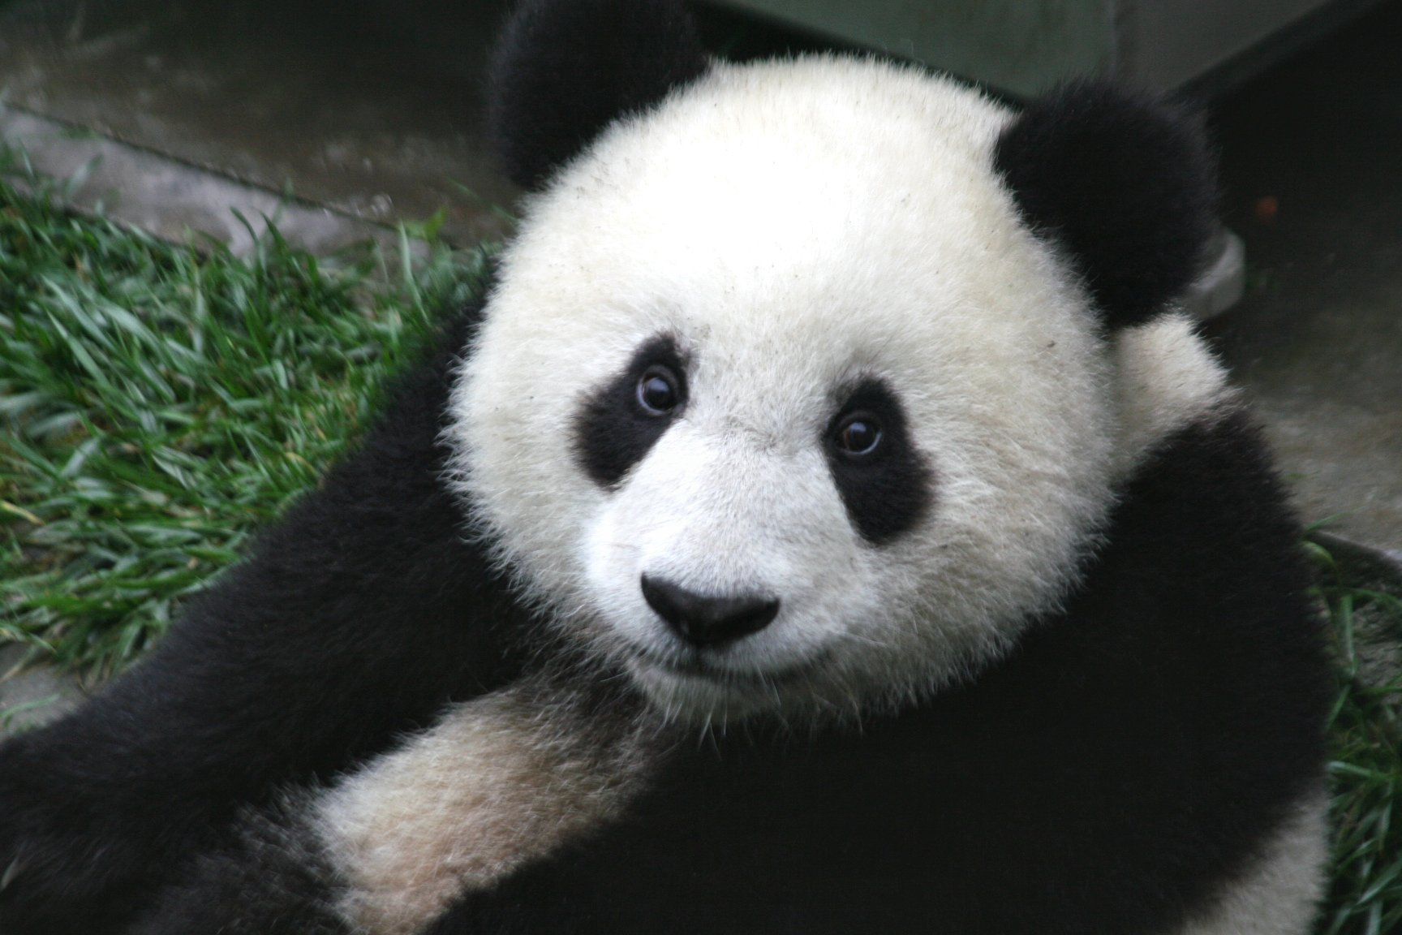
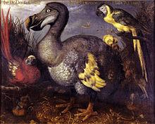
Problem Identification
Giant pandas are being endangered with only about 2,500 of them left in the world.
The factors that cause the large number of pandas to die are hunting, poaching, habitat destruction, and human interferences that prevents them from breeding.
These disasters are causing two-thirds of the panda population to be protected.
Even tourism is affecting pandas by creating disturbance in their habitats.
Bamboo trees are getting destroyed because of human interferences.
Pandas eventually will become extinct like the dodo bird in 1681 if these problems continue to occur.
Currently there is no global solution because only locals and the Chinese government are trying to address these problems, specifically bamboo deforestation. Also, there is not enough funding.
Notes:
For #2 say the leading factors that cause this is … Habitat Destruction and Humans interfering with breeding (Rohan) if they ask why say Isolation of deforestation

Slide 5
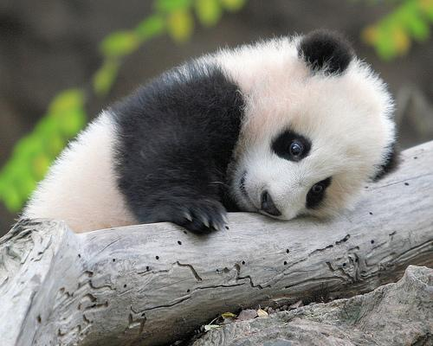
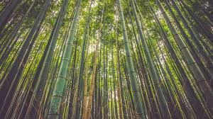
Problem Analysis
Deforestation for agricultural land, roads, and logging are bad for the habitats of pandas. These problems force the pandas to live in higher elevation, which isolates them into separate groups.
This also prevents pandas to move freely to find bamboo because other predators such as leopards and wild dogs will prey on young pandas.
99% of Panda’s diet is bamboo. They eat 16 hours a day.
People use the forest as a dump of waste which is kicking the pandas out of their homes.
Since the population of China is one billion, more land will be used, and more bamboo will be cut down for houses and paper.
Sometimes pandas give birth to 2 cubs but only one survives. Baby pandas are pretty vulnerable when they are younglings because their eyes are shut closed.
Females are interested in males only for two to three days. This is bad because female giant pandas give birth between 95 and 160 days after mating.
When there is deforestation, pandas become isolated which causes them to not be able to reproduce. The problem is bamboo deforestation and insufficient funding.
Notes:
Speak Clearly and Quickly. (Team)

Slide 6

Existing solutions
If you are a landowner or a farmer, you can grow and donate bamboo to a zoo or plant more bamboo to increase the size of panda habitats.
You also can sponsor or adopt a panda through the website, Pandas International.
Almost everything can be recycled, so make sure you do it, because the garbage you do not recycle gets dumped in forests. One ton of recycled paper saves about 17 bamboo trees that are homes to pandas.
As you can see people are already trying to help with reforestation but their solutions are not working at a fast rate.
This problem is only being tackled by the locals of this area.
Our team solution will create awareness to get people from around the world involved in solving major issue of bamboo deforestation.
Notes:
Speak Clearly and Quickly. (Team)

Slide 7


Team Solution
Our team solution is to solve deforestation problem in two parts: A mobile app named My Pet Panda and a GoFundMe Donation Page
The idea for this app is to give pandas out for donation when people donate money for the cause of panda deforestation.
Every panda that is let back in the wild will be attached with a GPS tracker. The pandas that are adopted will also come with a code.
The first step to take care of the panda is to name it. When someone downloads our app they will need to enter in the name of the panda and the code that came with it in order to create a profile.
My Pet Panda will be used to track the adopted panda. The app will allow people to track where the panda has been throughout the day and see the status of the panda’s health.
The owner of the panda can take pictures and add posts to our website and/or social media sites.
Every panda will only be allowed to be adopted for six months. This is because we want more donations and the only way to adopt a panda again is by donating.
If you put hard work into caring your panda then the panda will be able to be adopted for an extra one week as a reward.
Notes:
Speak Clearly and Quickly. (Team)

Slide 8

Innovative Solution
“My Pet Panda” Mobile Application
Our solution is UNIQUE and innovative because:
Persuades people to donate without obligating them.
Effective. We used our My Pet Panda application to drive donations and awareness. So far we have collected more than $850 for our cause and it is increasing!!!
Creates global awareness, not just local issue
Helps the Panda population grow in a fun and interesting way.
Accelerates reforestation at a quick pace.
We use gamification to make people want to adopt pandas for more time.
We used the website GoFundMe to collect donations.
URL: https://www.gofundme.com/fll-machines-inc-save-the-pandas
We used advanced technology such as GPS to track adopted pandas.
We used social media to share and spread our unique idea.
We even partnered up with Pandas International to:
Make sure our donations will reach right panda organizations in China.
Share and Spread our unique idea.
URL: https://www.youtube.com/watch?v=P74erAMCgu0&t=6s
URL:https://www.facebook.com/Pandas-International-15195436827/?hc_ref=PAGES_TIMELINE&fref=nf
Notes:
Amrik’s and Noah Slide

Slide 9
Implementation
Low application development cost.
Partnership with Pandas International organization.
Costs a very skosh amount of money and does not take much time to create.
Even though our solution does not cost much and take much time to create, it is a very helpful solution to save pandas.
It is also very easy to create and convenient to use.
It takes some time but it is worth every second because it helps save pandas from becoming extinct.
Partnership helps create awareness and collect more donations.
Notes:
Speak Clearly and Quickly. (Team)

Slide 10
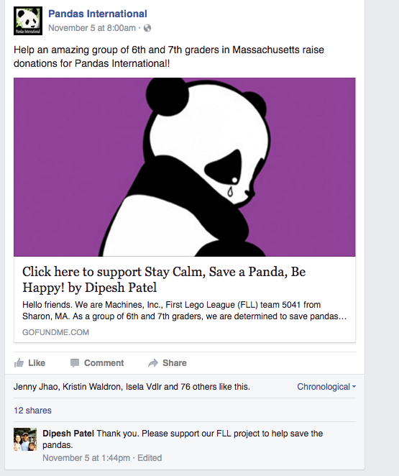
Sharing
So far we have collected $850
“Love the video! It was great to see the faces of the kids. Let us know if you need anything more from us. They did such a wonderful job with their questions yesterday. We have had two other schools contact us about the same project and your students were by far the best questions we have had!”
Andrea Muller
Assistant Director/Adoption Coordinator
Pandas International
Gofundme: https://www.gofundme.com/fll-machines-inc-save-the-pandas
Pandas International
Facebook: https://www.facebook.com/Pandas-International-15195436827/?hc_ref=PAGES_TIMELINE&fref=nf
Youtube: https://www.youtube.com/watch?v=fxv3h_MfuBQ
Students and Teachers at SMS
FLL Forums
Friends and Family
Notes:
Rohan’s Slide

Slide 11
Creativity
We already knew that there were many solutions that contained the ideas of saving pandas. But we thought outside the box and ended up with a final solution of an app that holds a GPS tracker using Google Maps and the idea of adopting pandas through partnership with an experienced organization, Pandas International.
Notes:
Not Presenting This Slide

Slide 12
Sources of Information
Interview with Panda expert from Pandas International, Andrea Muller, Assistant Director
http://wwf.panda.org/what_we_do/endangered_species/giant_panda/
http://annithrumpf.weebly.com/reproductive-system.html
http://english.cri.cn/725/2006/01/06/202@41618.htm
http://www.chinagiantpanda.com/pandafaq/pandathreat.htm
https://www.youtube.com/watch?v=ngMDjuxybA4
http://www.worldwildlife.org/species/giant-panda
http://www.cnn.com/2016/09/04/world/giant-panda-endangered-downgrade-gorillas-decline
http://www.bbc.com/news/world-asia-china-37273337
https://sites.google.com/site/rbgiantpanda/reproductive-system
http://www.pbs.org/
https://www.google.com/search?q=we+are+a+team&source=lnms&tbm=isch&sa=X&ved=0ahUKEwj6p_Ot_s7QAhVDj1QKHWzbAnEQ_AUICCgB&biw=1920&bih=1000#imgrc=LKMyJVLVQh0PTM%3A
https://www.google.com/search?q=bamboo+tree&source=lnms&tbm=isch&sa=X&ved=0ahUKEwjbpKD8_s7QAhUrxFQKHZqHA6IQ_AUICCgB&biw=1560&bih=859#imgrc=musfr02BlTdc8M%3A
https://www.google.com/search?q=recycle&source=lnms&tbm=isch&sa=X&ved=0ahUKEwj7ucDL_87QAhVDyGMKHRzpDGkQ_AUICCgB&biw=1560&bih=859#imgrc=ietA-DLa7tIUGM%3A
https://www.google.com/search?q=app+store+logo&source=lnms&tbm=isch&sa=X&ved=0ahUKEwi41KOJgM_QAhVW9mMKHT1wCqUQ_AUICCgB&biw=1560&bih=859#imgrc=Z6-CI0RGXiH-6M%3A
https://www.google.com/search?q=app+store+logo&source=lnms&tbm=isch&sa=X&ved=0ahUKEwi41KOJgM_QAhVW9mMKHT1wCqUQ_AUICCgB&biw=1560&bih=859#imgrc=CIR7kJB5I8nBpM%3A
https://www.google.com/search?q=go+fund+me+logo&tbm=isch&imgil=TvSH3myK8EZU5M%253A%253B0K-iQPo6zp5HSM%253Bhttps%25253A%25252F%25252Fwww.gofundme.com%25252F&source=iu&pf=m&fir=TvSH3myK8EZU5M%253A%252C0K-iQPo6zp5HSM%252C_&usg=__NtQfwBeUKZcM-U-waRm-jzW8dh8%3D&biw=1560&bih=859&ved=0ahUKEwihqaSRgc_QAhULq1QKHXKTB-0QyjcINg&ei=bwA-WOG1LYvW0gLypp7oDg
Notes:
Anish’s slide

Slide 13






THANK
YOU
Notes:
Team Slide

Slide 14
Appendix
Screenshots for My Pet Panda Mobile Application
Home Screen
Panda Tracker
Health Monitor
Social Sharing
Updates
Blog
Notes:
Team Slide

Slide 15

My Pet Panda App:
Home Screen
My Pet Panda
Panda Health
Gin Gin
Good Health
Temp. 91
Panda Location
Location
Panda Share
Panda
Updates
Facebook Shares:
Vidhur, Amrik, Rohan, Anish, and Noah
Panda Blog
6 Months Left
Notes:
App Image 1

Slide 16
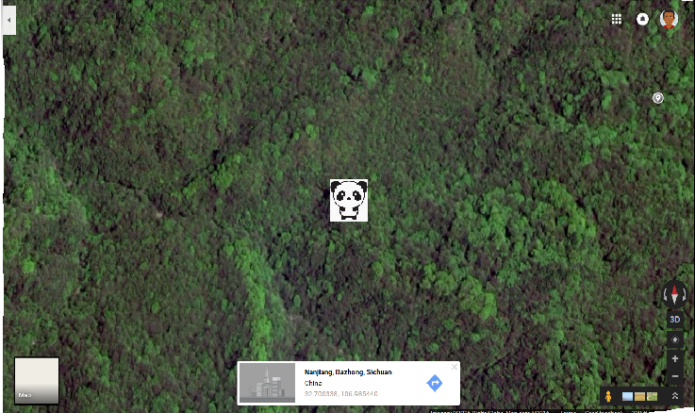
My Pet Panda App:
Panda
Tracker
My Pet Panda
Panda Location
Gin Gin
Is in China
Location
Notes:
App Image 2

Slide 17
My Pet Panda App:
Health Monitor
My Pet Panda
Panda Health
Gin Gin
Is in Good Condition
Activity
Walked 4,000
Steps
Sleep
Slept
12 Hours
Bamboo Eaten
30 kg of bamboo
Notes:
App Image 3

Slide 18
My Pet Panda App:
Social Sharing
My Pet Panda
Panda Share
Gin Gin
5 Shares
Shared with:
Vidhur, Amrik, Rohan, Anish, and Noah
Notes:
App Image 4

Slide 19
My Pet Panda App:
Updates
My Pet Panda
Panda Updates
Gin Gin
1 Update
Pandas are off the endangered list.
Notes:
App Image 5

Slide 20
My Pet Panda App:
Blog
My Pet Panda
Panda Blogs
Gin Gin
2 Blogs
Blogs From...
Andrea Muller
Vidhur, Amrik, Rohan, Anish, and Noah
Notes:
App Image 6

